Slide 1
Image-Based Situation Awareness Audit 1.3.2018
Sakari Lampola

Slide 2
Previous Audit 11.1.2018

Slide 3
Open questions:
Role of classical object tracking alrorithms?
What to do with multiple bounding boxes around one object?
Appropriate minimum confidence level?
What to do with false detections inside other objects?
What to do with false detections from the background?
How to set Kalman filter parameters for image object filtering?
Hungarian algorithms special case for hidden objects
To do:
Close open questions
Image object status
Image object velocity estimation
Probabilistic approach for matching detected and image objects
2d -> 3d transformation
World object state estimation
Other:
Semantic segmentation
Organisations to follow: ICCV, ICRA, NIPS, IROS, arXiv
Camera motion (yaw, pitch)
Grid or continuos presentation?
Class specific attributes
Object history
Previous Audit

Slide 4
Work Done

Slide 5
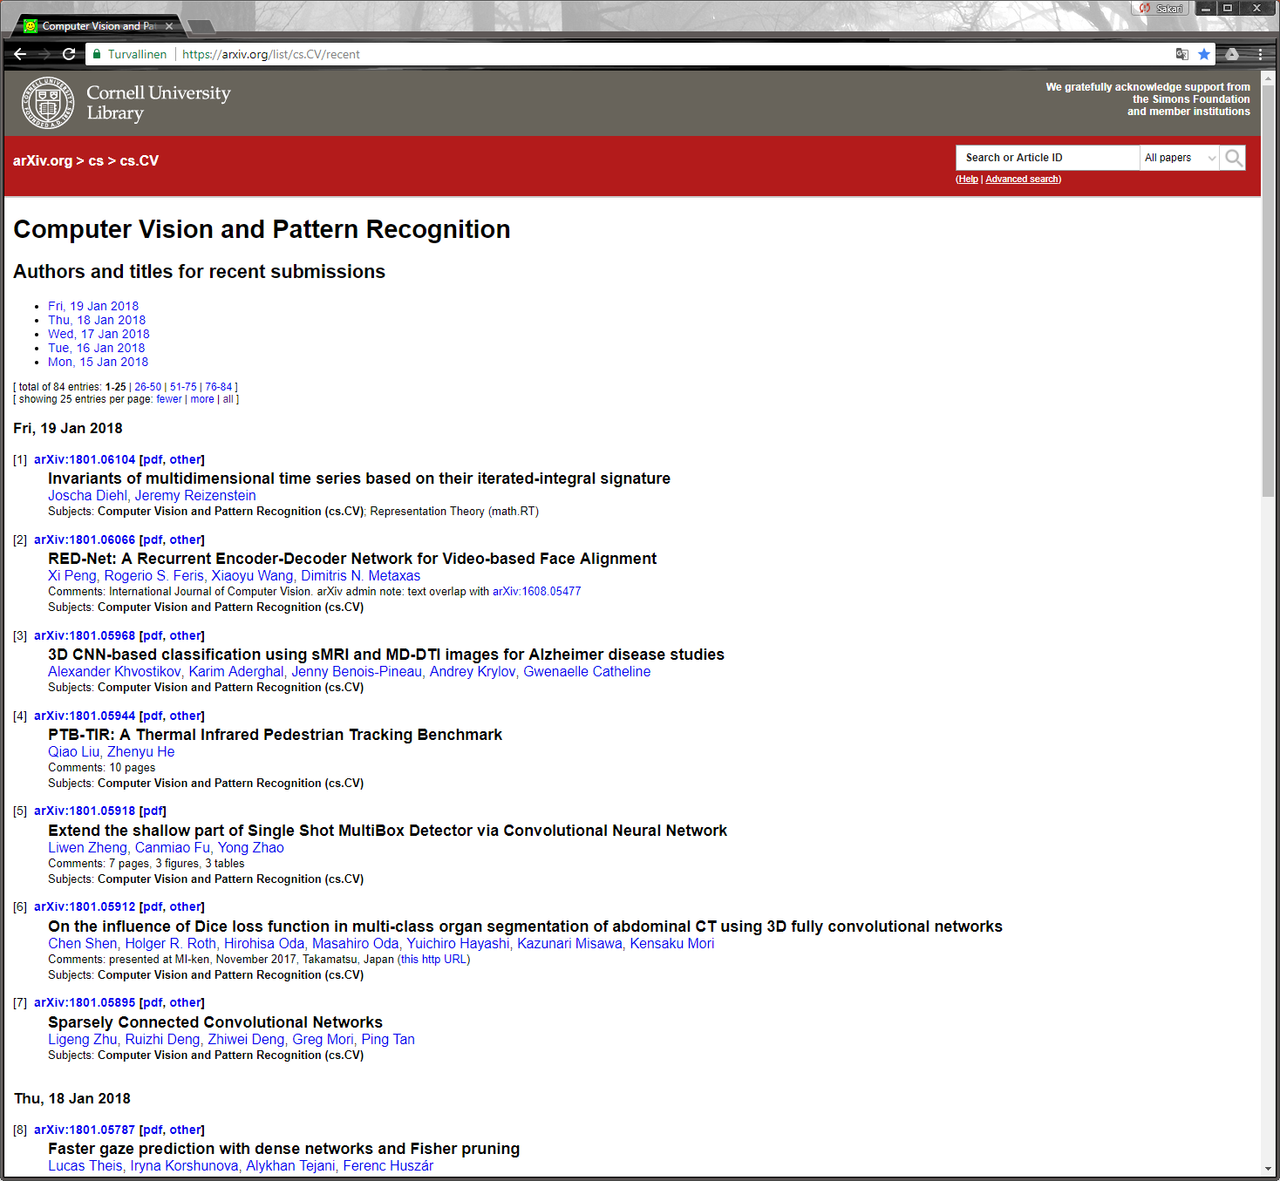
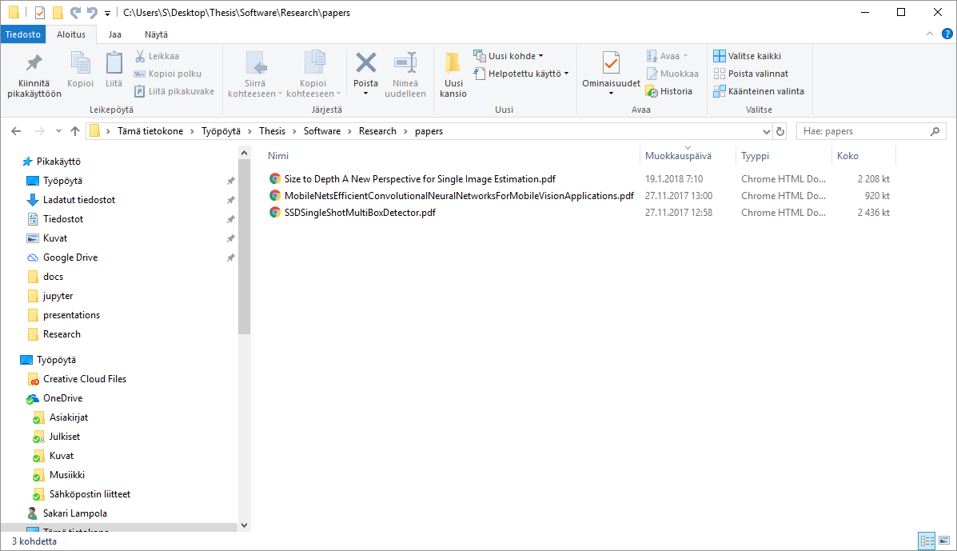
Method Follow-Up

Slide 6
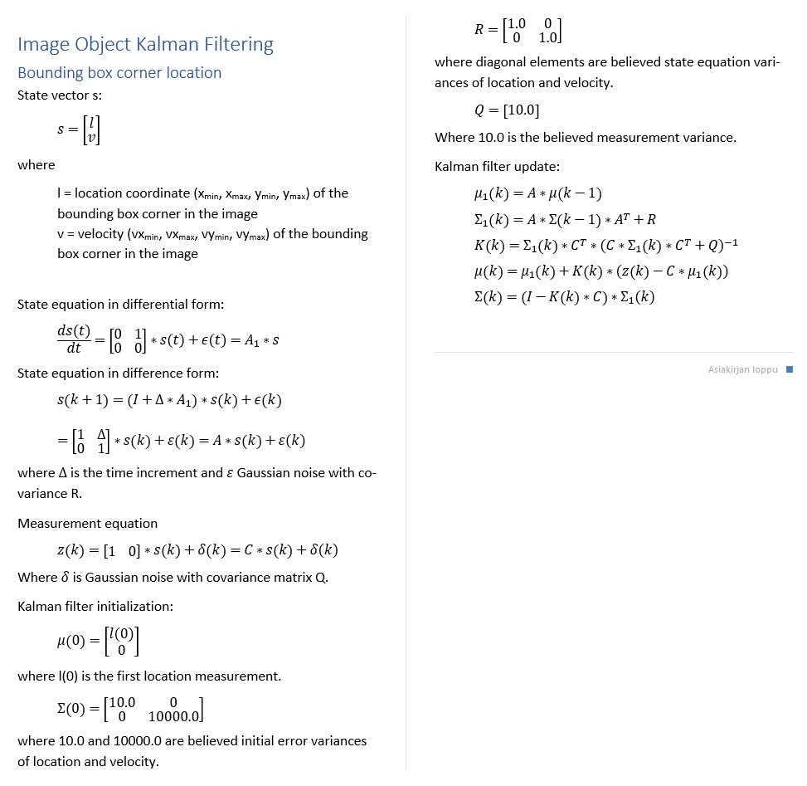
Image object velocity is necessary for:
predicting image object locations when matching new measurements
identifying image objects
predicting image object locations for hidden objects
Image object
id
status
x_min
x_max
y_min
y_max
vx_min
vx_max
vy_min
vy_max
class
confidence
appearance
Image Object Velocity Estimation
Estimation algorithm
Numerical values are estimated using grid search and 10 step ahead
mean prediction error. Values rounded.

Slide 7
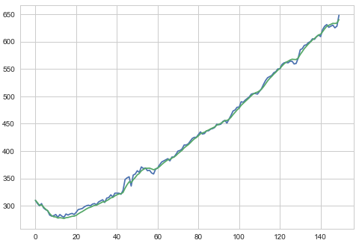
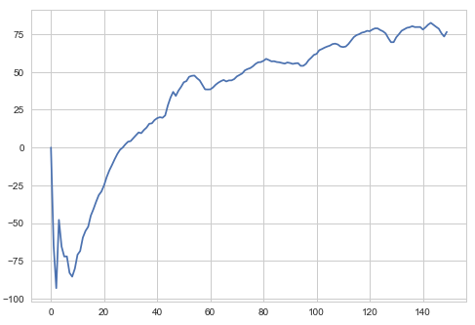
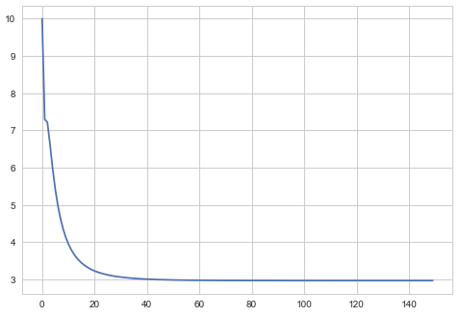
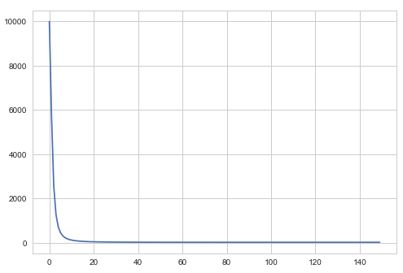
Moving object (car)
Image Object Velocity Estimation
Measured and filtered location (upper left corner)
Estimated velocity
Location variance
Velocity variance

Slide 8
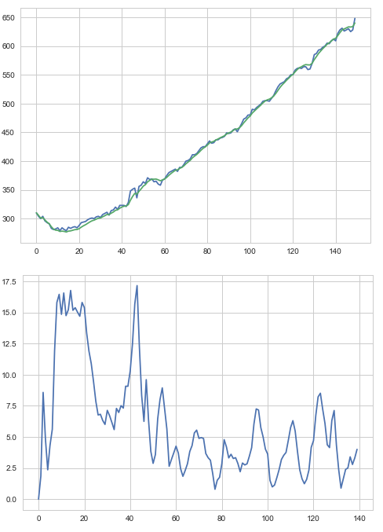
Moving object (car)
Image Object Velocity Estimation
10 step ahead mean prediction error

Slide 9
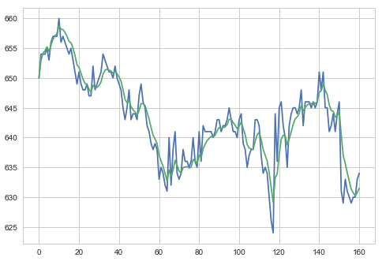
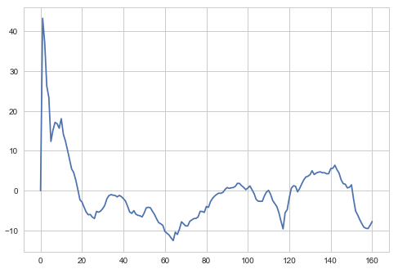
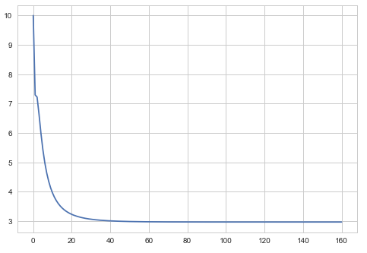
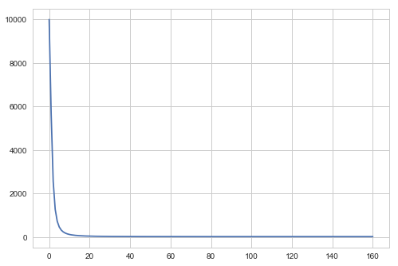
Static object (calf)
Image Object Velocity Estimation
Measured and filtered location (upper left corner)
Estimated velocity
Location variance
Velocity variance

Slide 10
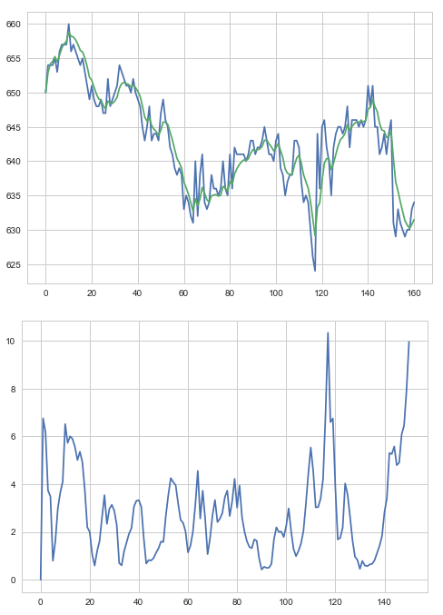
Static object (calf)
Image Object Velocity Estimation
10 step ahead mean prediction error

Slide 11
Software Architecture
Speech Synthesis
Video file
Camera
OpenCV
AnalyzeVideo
ObjectDetection
Speakers
ImageClasses
MobileNetSSD (caffe)
pyttsx3
SpeechSynthesis

Slide 12
Entities
Speech Synthesis
Image World
Image Object
Event
Event
time
text
priority
Event is generated when
new image object is created
image object status is changed
Event will pause the video for the duration of speech (not in the final version)
Events are collected (history)

Slide 13
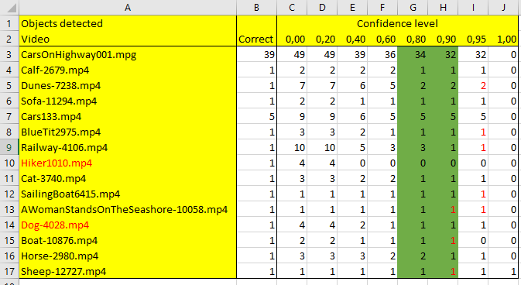
SSD Mobilenet implementation:
# extract the confidence (i.e., probability) associated with the prediction
Confidence Level
Good value for creating a new image object is between 0.8 and 0.9.
The ’good’ value also depends on other hyperparameters.

Slide 14
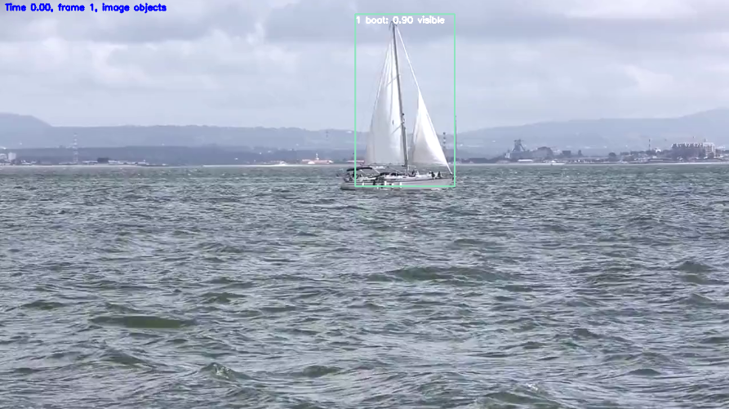
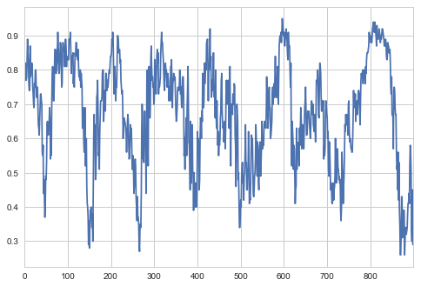
Confidence Level
Confidence level has dynamics
create
Update (not class)
ignore
Different levels for creating and updating image object. Hyperparameters:
CONFIDENCE_LEVEL_CREATE (0.8)
CONFIDENCE_LEVEL_UPDATE (0.4)

Slide 15
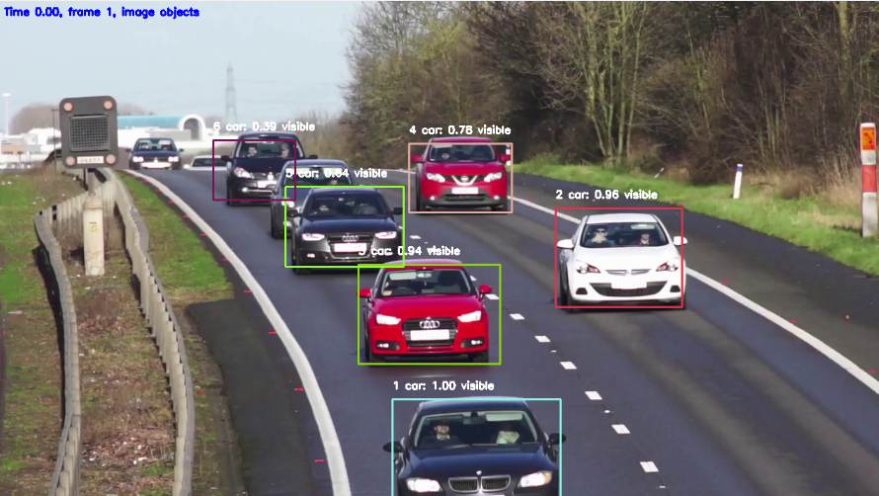
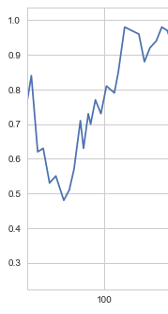
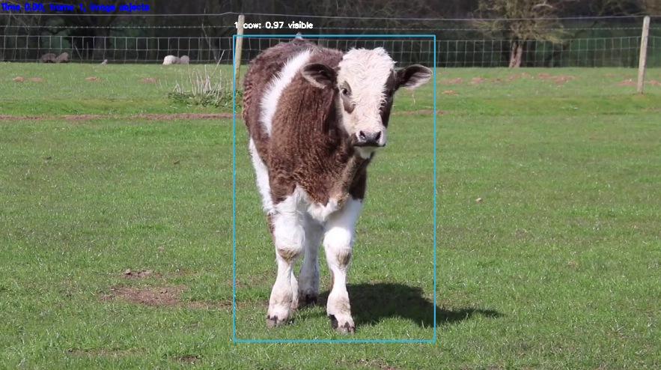
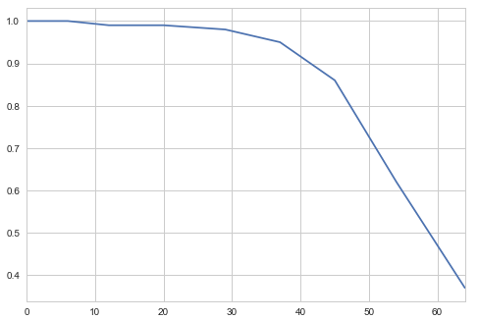
Confidence Level

Slide 16
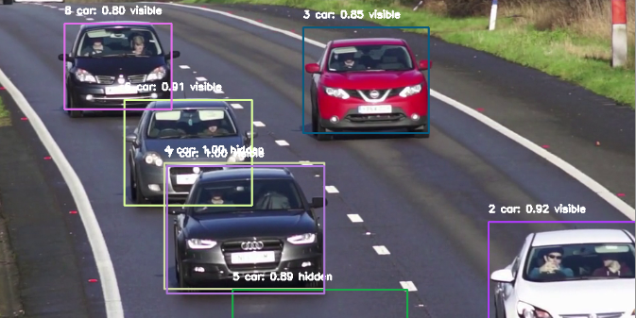
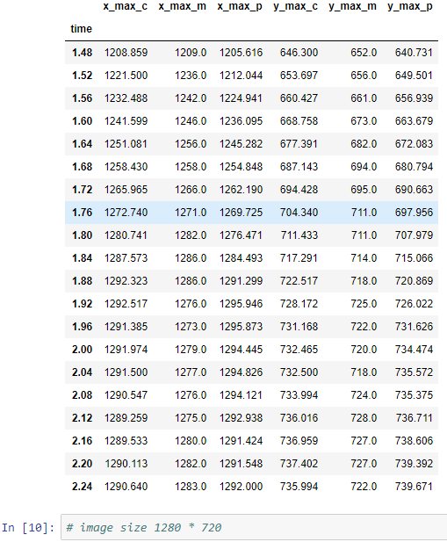
Box size and form distorded
Border Behaviour
When one of the corners approaches image border, the image object is removed
Image object is not created if one of the corners is in the border area
The corresponding world object continues to live in 3d world, with acceleration fixed
Hyperparameter BORDER_WIDTH
Condition for removal & creation prevention:
x_min < BORDER_WIDTH or
x_max > image_width - BORDER_WIDTH or
y_min < BORDER_WIDTH or
y_max > image_height - BORDER_WIDTH
All types of coordinates applied (measured,
predicted and corrected)

Slide 17
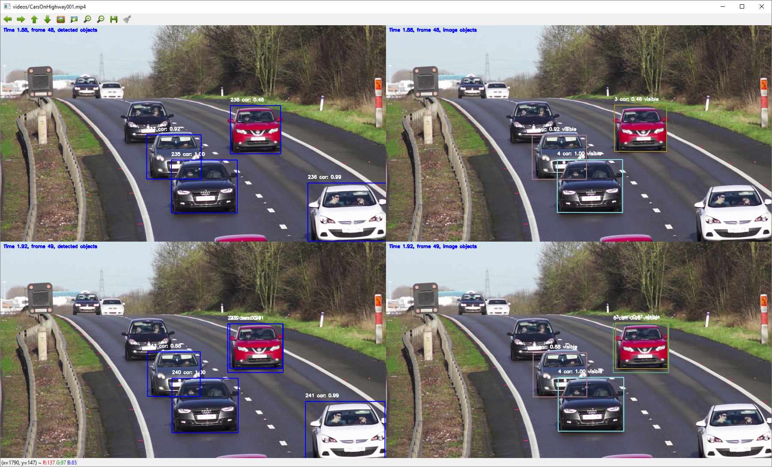
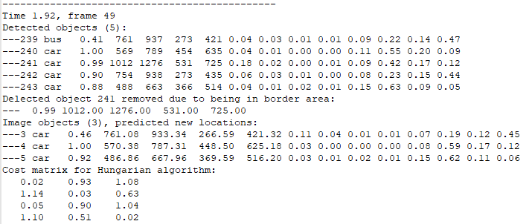
Duplicate Prevention

Slide 18
Duplicate Prevention
Solution:
Change of class not permitted or is heavily penalized (large distance)
New image object is not created if the distance is very small to existing image object

Slide 19
Work in Progress

Slide 20
Perception
“The first step in achieving SA is to perceive the status, attributes, and dynamics of relevant elements in the environment. Thus, Level 1 SA, the most basic level of SA, involves the processes of monitoring, cue detection, and simple recognition, which lead to an awareness of multiple situational elements (objects, events, people, systems, environmental factors) and their current states (locations, conditions, modes, actions).”

Slide 21
Next Steps

Slide 22
Next steps
Comprehension:
Closing the open questions
2d -> 3d transformation
World object state estimation

Slide 23
To Be Discussed

Slide 24
Method follow-up
Google search enough?
Good way of following new papers?

Slide 25
Thank you!
lampola@student.tut.fi
https://github.com/SakariLampola/Thesis

